Slide 1
Advanced Object Manipulation
Five of the different types of “Objects” in Object-Oriented programming:
Classes, Decorators, Iterators, Generators, Lambdas

Slide 2
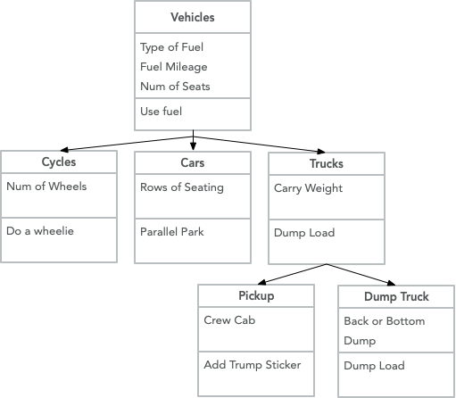
Classes and Sub-Classes
Most Common of the Objects
Can be used without an __init__ statement but gains its power from inheritance and properties
Use super().__init__() to ensure method resolution order

Slide 3
Decorators
def star(func):
def inner(*args, **kwargs):
print("*" * 30)
func(*args, **kwargs)
print("*" * 30)
return inner
def percent(func):
def inner(*args, **kwargs):
print("%" * 30)
func(*args, **kwargs)
print("%" * 30)
return inner
@star
@percent
def printer(msg):
print(msg)
printer("Hello")
def decorate_any_function(func):
def inner(*args, **kwargs):
print(”Decorating any function")
return func(*args, **kwargs)
return inner
@decorate_any_function
def some_function():
pass
Accepts a function, adds some functionality, returns the function
Can use specific variable names or *args, **kwargs
*args = positional arguments
**kwargs = key word arguments
****************************** %%%%%%%%%%%%%%%%%%%%%%%%%%%%%% Hello %%%%%%%%%%%%%%%%%%%%%%%%%%%%%% ******************************
https://www.programiz.com/python-programming/decorator

Slide 4
Iterators
>>> a = PowTwo(4)
>>> i = iter(a)
>>> next(i) 1
>>> next(i) 2
>>> next(i) 4
>>> next(i) 8
>>> next(i) 16
>>> next(i) Traceback (most recent call last):
...
StopIteration
class PowTwo:
"""Class to implement an
Iterator of powers of two"""
def __init__(self, max = 0):
self.max = max
def __iter__(self):
self.n = 0
return self
def __next__(self):
if self.n <= self.max:
result = 2 ** self.n
self.n += 1
return result
else:
raise StopIteration
Implements __iter__
Implements next
Lists, Dictionaries (returns Tuples), Sets
Usable in For...Next Loop
dict.items() or dict.iteritems() <-lazy(on-demand)
>>> for i in PowTwo(5):
... print(i)
...
1
2
4
8
16
32
https://www.programiz.com/python-programming/iterator

Slide 5
Generators
# a generator that yields items instead of returning a list
def firstn(n):
num = 0
while num < n:
yield num
num += 1
sum_of_first_n = sum(firstn(1000000))
Declare a function that acts like an iterator
Do not need to declare __init__ or next functions
Helpful if you don’t need the list – saves memory
https://wiki.python.org/moin/Generators

Slide 6
Lambdas
Syntax:
lambda arguments: expression
double = lambda x: x * 2
print(double(5))
Will ouput 10
Anonymous Functions
Useful for single-line functions that will not be re-used elsewhere
Improves readability ?
No need for def
# Program to filter out only the even items from a list
my_list = [1, 5, 4, 6, 8, 11, 3, 12]
new_list = list(filter(lambda x: (x%2 == 0) , my_list))
# Output: [4, 6, 8, 12]
print(new_list)
https://www.programiz.com/python-programming/anonymous-function

